Slide 1
SCRUM
Methodology

Slide 2
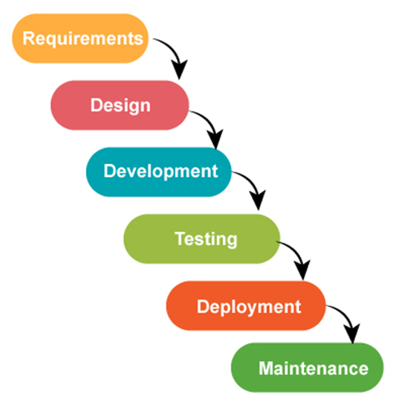
Waterfall
Notes:
Communication Gaps

Slide 3
Be Agile…

Slide 4
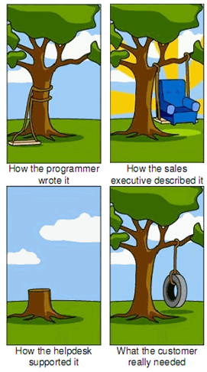
Agile Manifesto
Individuals and interactions over processes and tools
Working software over comprehensive documentation
Customer collaboration over contract negotiation
Responding to change over following a plan

Slide 5
Agile Manifesto – 12 Principles
Our highest priority is to satisfy the customer
through early and continuous delivery
of valuable software.
Welcome changing requirements, even late in
development. Agile processes harness change for
the customer's competitive advantage.
Deliver working software frequently, from a
couple of weeks to a couple of months, with a
preference to the shorter timescale.
Business people and developers must work
together daily throughout the project.
Build projects around motivated individuals.
Give them the environment and support they need,
and trust them to get the job done.
The most efficient and effective method of
conveying information to and within a development
team is face-to-face conversation.
Working software is the primary measure of progress.
Agile processes promote sustainable development.
The sponsors, developers, and users should be able
to maintain a constant pace indefinitely.
Continuous attention to technical excellence
and good design enhances agility.
Simplicity--the art of maximizing the amount
of work not done--is essential.
The best architectures, requirements, and designs
emerge from self-organizing teams.
At regular intervals, the team reflects on how
to become more effective, then tunes and adjusts
its behavior accordingly.

Slide 6
Scrum
Notes:
1986 - concept
1993 – first project
1995 – formal
2001 – agile manifesto
Japanese Business Experts
Framework or Scaffold, not a process
Does not say ‘How’, but about ‘What’
Customize

Slide 7
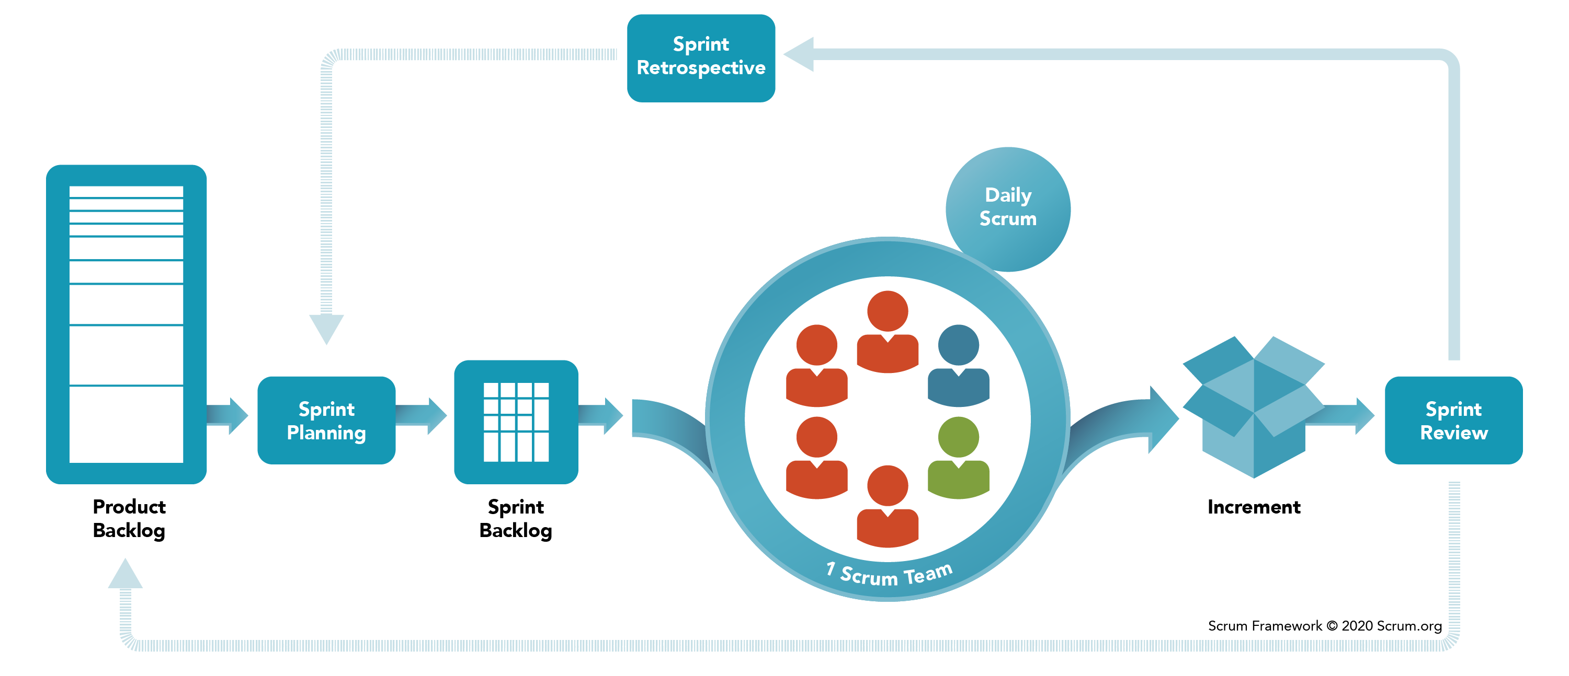
Scrum – Process view
Notes:
Orchestra

Slide 8

Scrum
Customize
Notes:
Customize to fit in the organization

Slide 9
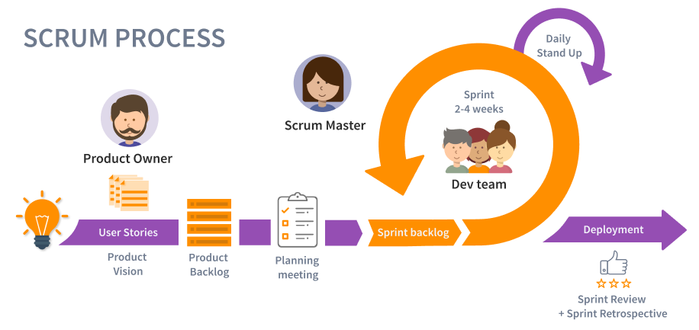
Scrum
Notes:
Orchestra

Slide 10
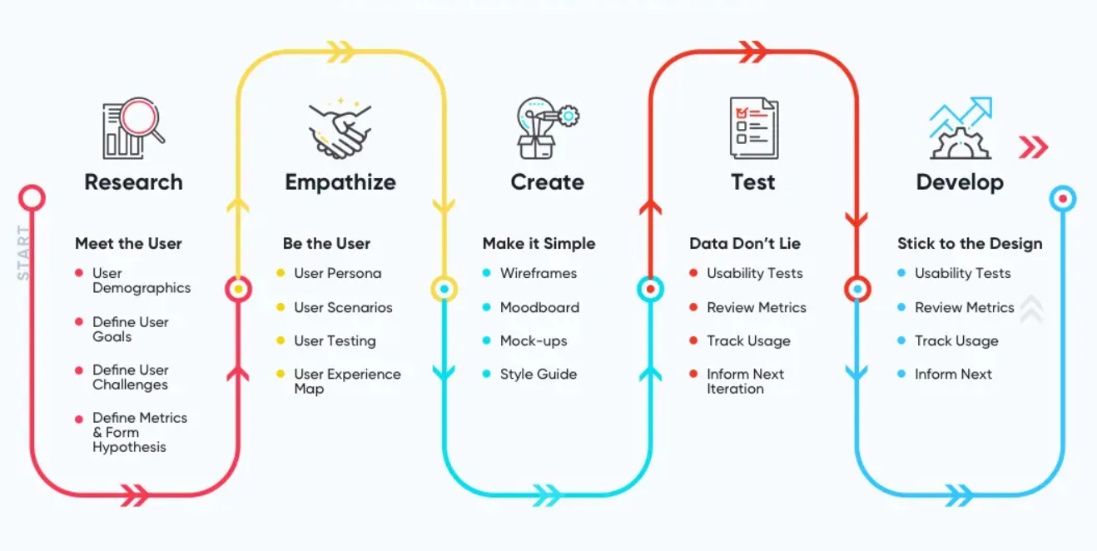
User Experience (UX) Design
Notes:
Orchestra

Slide 11
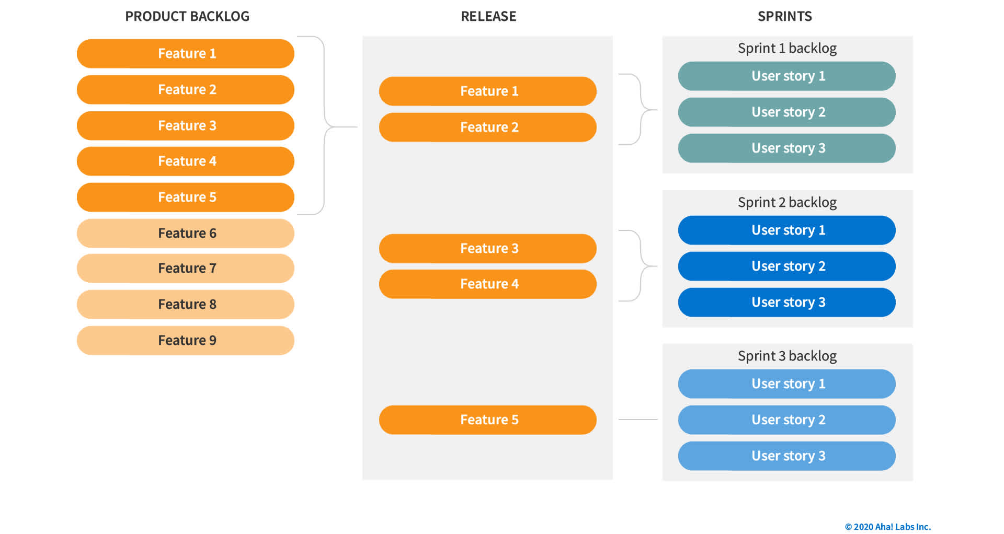
Product Backlog
DoR: Definition of Ready
DoD: Definition of Done

Slide 12
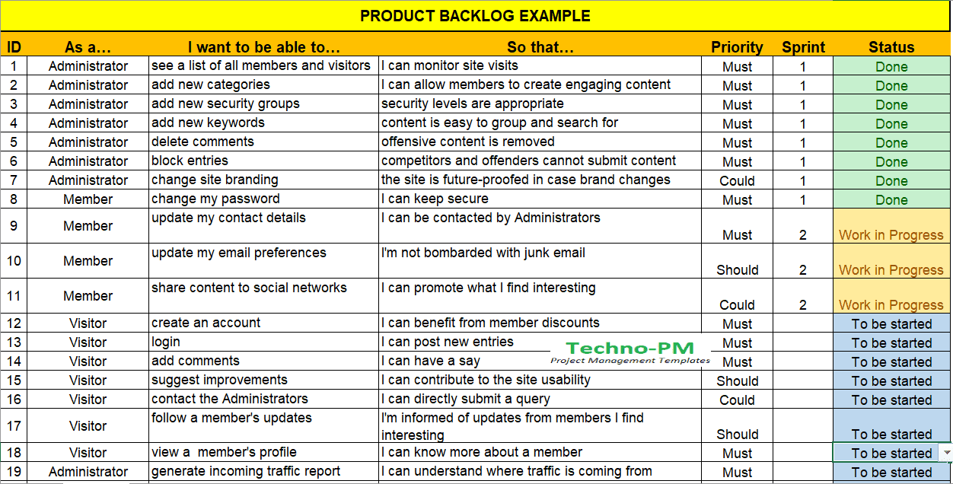
Backlog Example
Notes:
Orchestra

Slide 13
Sprint
Timeboxed iteration. Usually 2-4 weeks
Sprint Delivery – A fully testable, demoable, working software
Usually no changes are allowed, definitely no major ones.

Slide 14
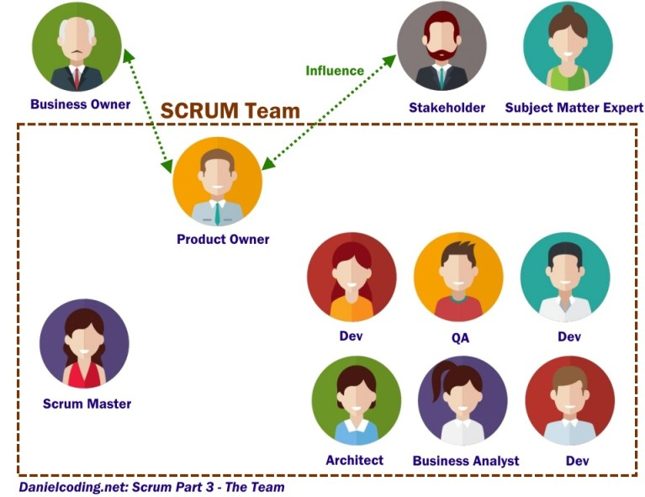

People
Program Manager
Project Manager
PMO
Image source: Danielcoding.net

Slide 15
Scrum Team
Self Organized
Cross-Functional
Committed and Available
Accountable
Example:
Lead Dev
Jr. Dev
QA
BA

Slide 16
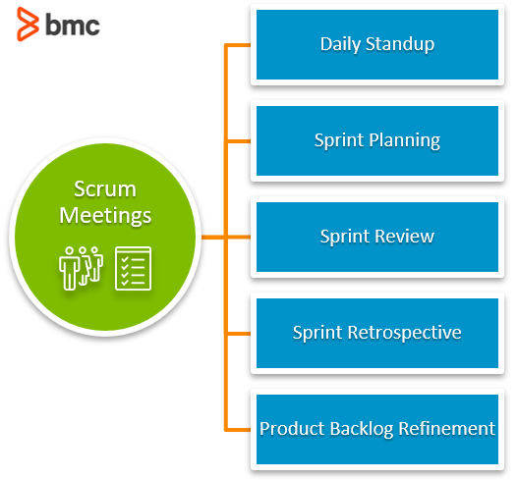
Meetings
Image source: bmc

Slide 17
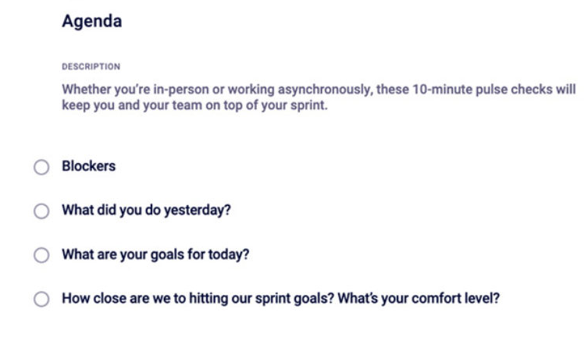
Daily Standup
Image source: bmc

Slide 18
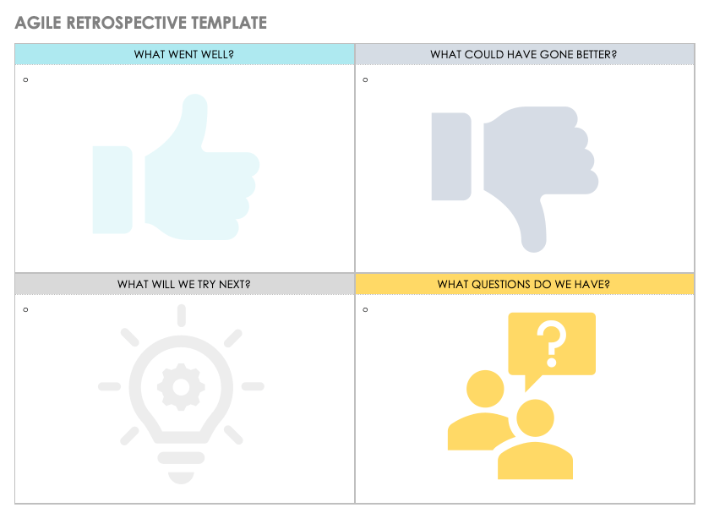
Sprint Retrospective

Slide 19
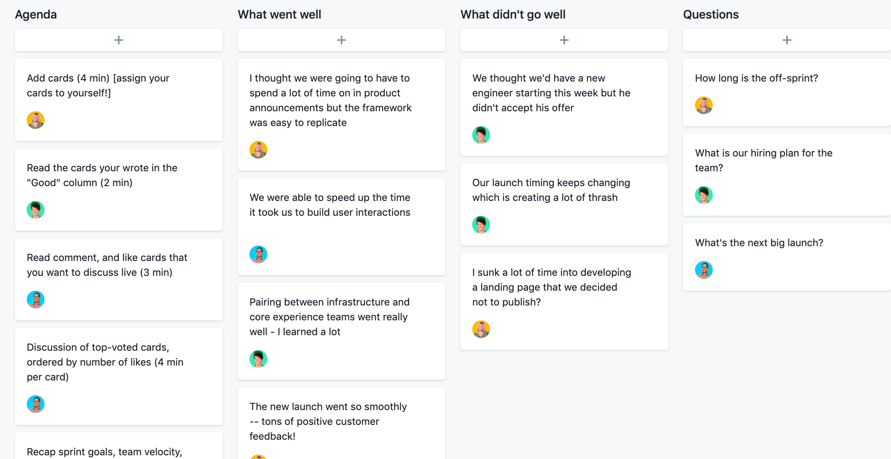
Sprint Retrospective - Sample

Slide 20
Documentation
General
SOW – Statement of Work
Business Requirements Documents
Product / Project / Software Requirements Document
High/Low Level Design Documents
Test Plans, Test Cases
User Guides, Installation Notes, Release Notes, FAQs, Build Plan
Scrum:
Product Vision
Roadmap
User Stories
Product Backlog
Retrospective
Meeting MoMs
Weekly Reports
Review Reports
Image source: bmc
Notes:
Teamplates

Slide 21
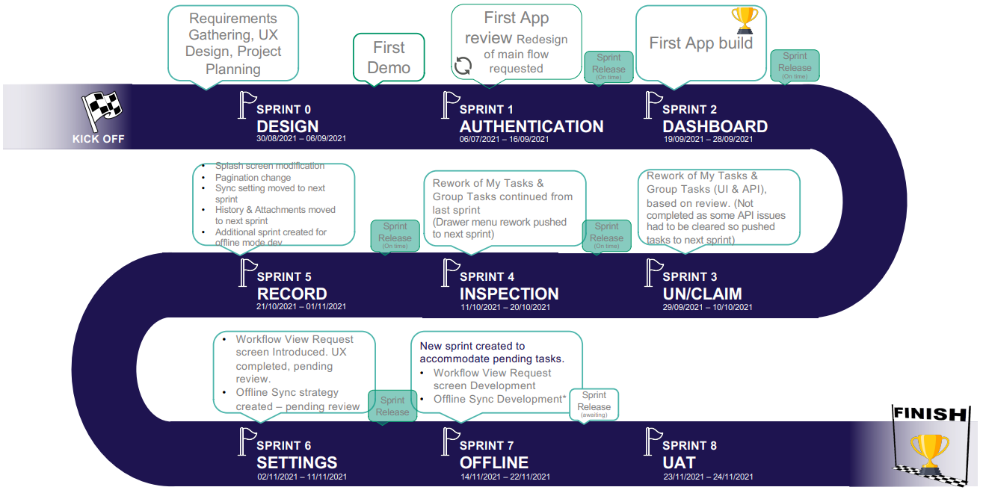
Custom Report Sample
Notes:
Teamplates

Slide 22
Tools
Jira
Microsoft Project
Azure DevOps
Microsoft Excel / Google Sheets
SharePoint / Organization Assets
Calendar
Mail
Image source: bmc
Notes:
Teamplates

Slide 23

DevOps
Image source: bmc

Slide 24

More Learning
Internet
LinkedIn Learning
Udemy
Training Programs by Professional Bodies

Slide 25
Certifications
CSM : Certified ScrumMaster by Scrum Alliance
PSM : Professional Scrum Master by Scrum.org
CSPO: Certified Scrum Product Owner
PSPO: Professional Scrum Product Owner
CSD: Certified Scrum Developer
PSD: Professional Scrum Developer

Slide 26
Disadvantages
No system is perfect
There is no one size fit for all
Continuous Training is necessary
Too many meetings (?)
If not managed properly, some parts can go wrong
If not monitored/audited properly, process can go wrong
Notes:
Teamplates

Slide 27

Thank You

